Slide 1
KS4 Options Information Evening
22nd January 2026

Slide 2
KS4 Options Information Evening
Information on the compulsory section of study for Years 10 and 11
Information on what to consider before making choices
The process
How to fill in the online form
Support, advice and guidance

Slide 3

The CORE Curriculum
Maths
English literature and English language
Science
Core PE
PSRE

Slide 4

Routes through science
There are two routes through science which are as follows:
AQA Combined Science (Trilogy)
This leads to the equivalent of two GCSEs and covers a combination of all three subject areas
AQA Separate Sciences
This leads to three separate GCSEs in Biology, Chemistry and Physics
The route students will follow is determined by the science faculty in order to support you to get the best results. Both routes allow you to continue to study any science at A level.
Mr Grainger is available this evening to discuss this with you further if you require

Slide 5
Making your choices

Slide 6

Things to consider
Do you enjoy the subject?
How is the course assessed? e.g. 100% exam or 60% Non Examined Assessment + 40% exam
Have you chosen a broad and balanced range of subjects?
Have you suitably challenged yourself?
What are your aspirations and interests post 16?
We strongly recommend that you take a language, a humanity and an art/technical subject to show a broad range of skills and keep future pathways open

Slide 7
Don’ts!
Don’t choose subjects just because your friends are choosing them.
Don’t choose a subject just because you get on well with your teacher. You might well have a different teacher at KS4.
Don’t rush to complete your choices – think carefully and pick a subject for positive reasons after conducting research.
Don’t narrow your skill set by taking lots of very similar subjects.
Don’t assume that you will be able to switch to another subject at a later stage.
Don’t assume you will get all your choices – make your reserve choice count – you may end up studying this subject.

Slide 8

Help and support
KS4 Options evening
KS4 Options booklet
Subject PowerPoints
Subject teachers and Faculty Heads
Parents’ evenings
Tutors
Miss Witchell – Careers Advisor (P3)
Miss Dundas/Mr Burcombe
Mrs Zuanella/Mrs Heavenwhite SENDCo/Deputy SENDCo) (P2)
Dr Simpson

Slide 9

The Options System
There are no set pathways. All students will get the same option form and the same choices
You must choose 4 options
At least one of those options must be one of the following:
  French
  German
  Spanish
  Geography
  History
  Computer Science

Slide 10

Things to note
Physical Education
If you want to do a PE qualification then select the Physical Education box
PE teachers will make the selection about which course you should follow based on what they know about you and which course will suit you best
Languages
Most suitable for those of you who are studying the language this year
If you want to take a language that you are not currently studying then you must speak to your language teacher before completing the option form

Slide 11
Art and D&T subjects
We have two subject areas that offer more than one type of qualification.
  Art
  D&T
You cannot take more than one qualification in each of these areas
Art
  Art, Craft and Design
  Fine Art
  Photography
D&T
  Graphics
  Resistant Materials
  Textiles
Food does not come under the D&T umbrella for the options process so it is possible to take Food and Graphics for instance.

Slide 12

Will you get all four of your choices?
Most students will be able to study all of their choices however, sometimes we are not able to give you a particular subject because:
Not enough students request the subject to make up a class
More students ask for a subject than the available teachers or facilities can cope with
It is not possible to timetable the mix of courses you have chosen
Students may opt for a course which, in the judgement of teachers, is not well suited to them
All students need to select a reserve subject and you need to give this as much thought as the rest

Slide 13
What happens if a course is oversubscribed?
Priority on courses will be assigned to students using the following criteria:
Forms that are returned by the deadline will be given priority over forms that are late but there is NO first come, first served approach before the deadline
Students with higher attendance will be given priority over students with lower attendance (absences for medical reasons not included)
Students with fewer demerits will be given priority over those with more
Students with higher effort grades will be given priority over those with lower effort grades

Slide 14
Filling in the form

Slide 15
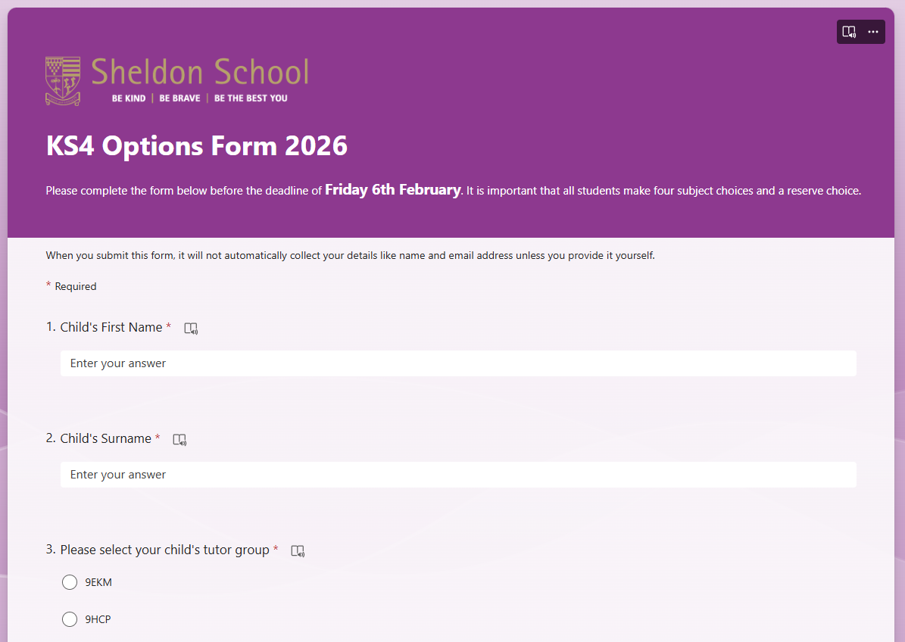
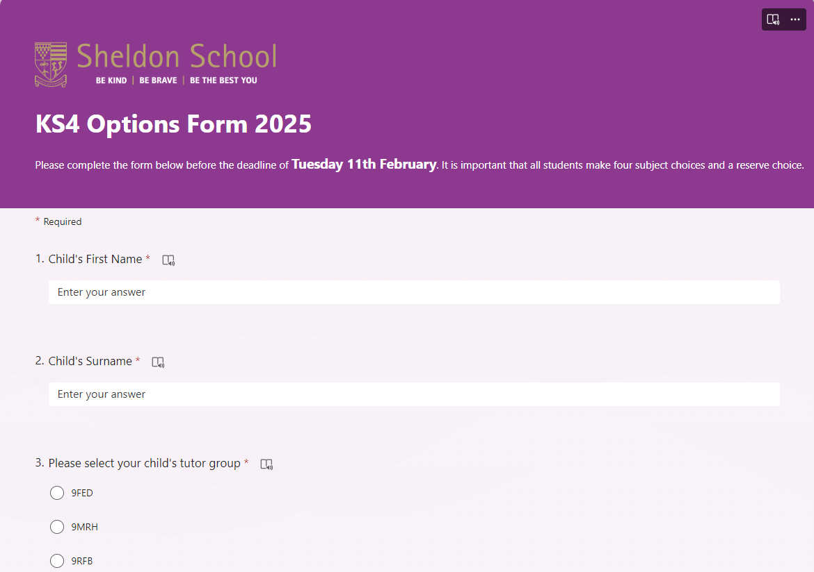
On-line Option Form
The Year 9 Options Form will be completed electronically
To access this form when it opens on Wednesday 28th January, please click on the button on the KS4 Options page on the school website – a reminder and a link will be emailed to all parents
The first part of the form asks you to complete your name and tutor group

Slide 16
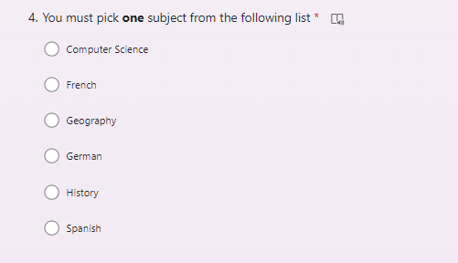
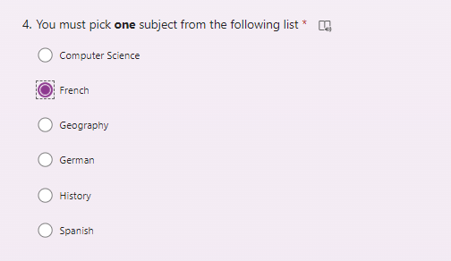
Question 4 on the form
You will then be asked to choose one of six subjects – you must pick one of these subjects

Slide 17
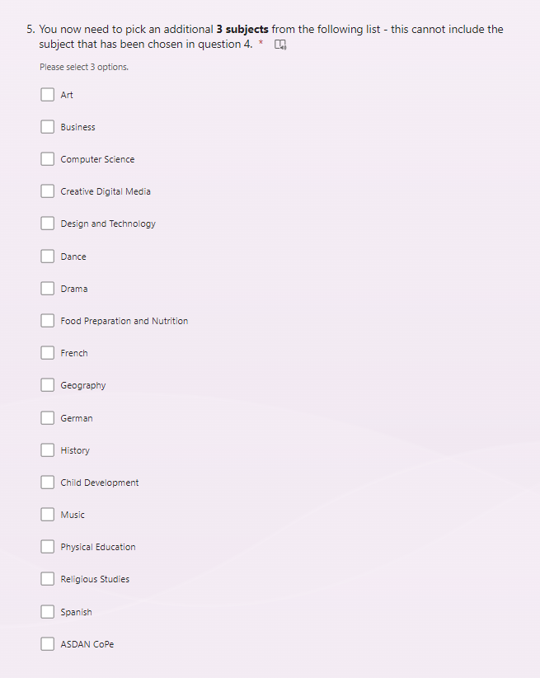
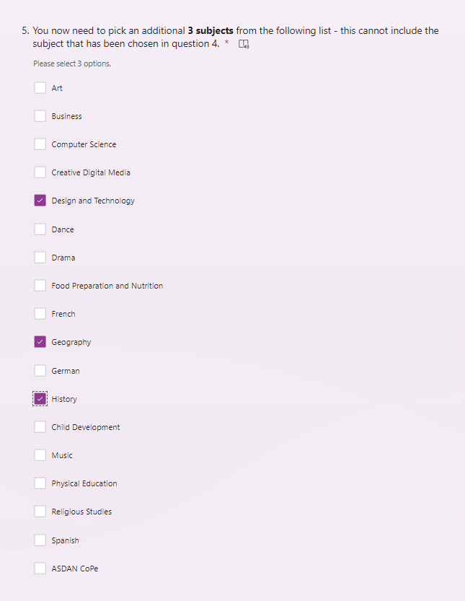
Question 5 on the form
Next, you will be asked to pick three additional subjects
Do not duplicate a subject from the previous question

Slide 18
Subjects with more than one qualification
We have two subject areas that offer more than one type of qualification.
  Art
  D&T
You cannot take more than one qualification in each of these areas therefore, the next two questions on the form ask you to choose which qualification in each subject area you would like to study if you have chosen that subject.
Remember, Physical Education does offer two different qualifications, but the route that students follow will be determined by the PE faculty. They know which qualification will suit students in order that students achieve the best possible outcomes.

Slide 19
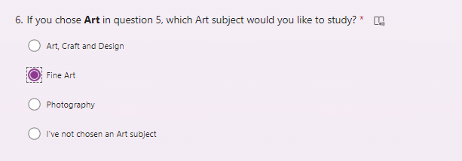
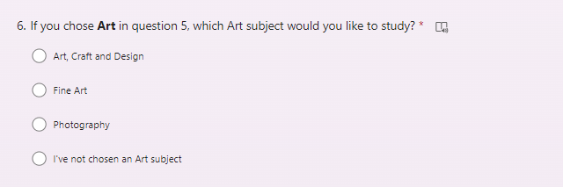
Questions 6 and 7 on the form
The next two questions on the form ask you to choose which qualification in each area you would like to study if you have made either an Art or a D&T choice
If however, you did not chose Art in question 5 then please select the button beside the statement ‘I’ve not chosen an Art subject’

Slide 20
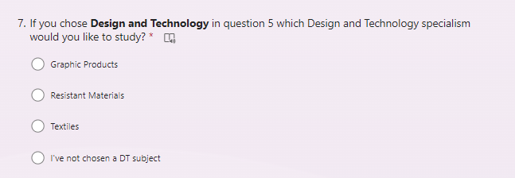
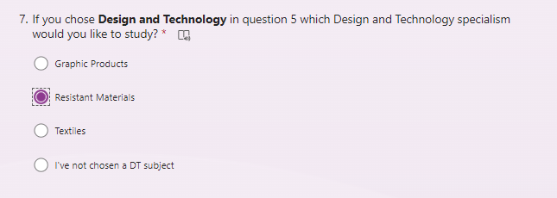
Questions 6 and 7 on the form
You will need to choose which D&T subject you want to study if this was one of your choices.
The reason for this is that the exam for these subjects is identical in part. However, you are able to take a D&T subject and Food if you want to.
If you did not chose D&T in question 5 then please select the button beside the statement ‘I’ve not chosen an D&T subject’

Slide 21
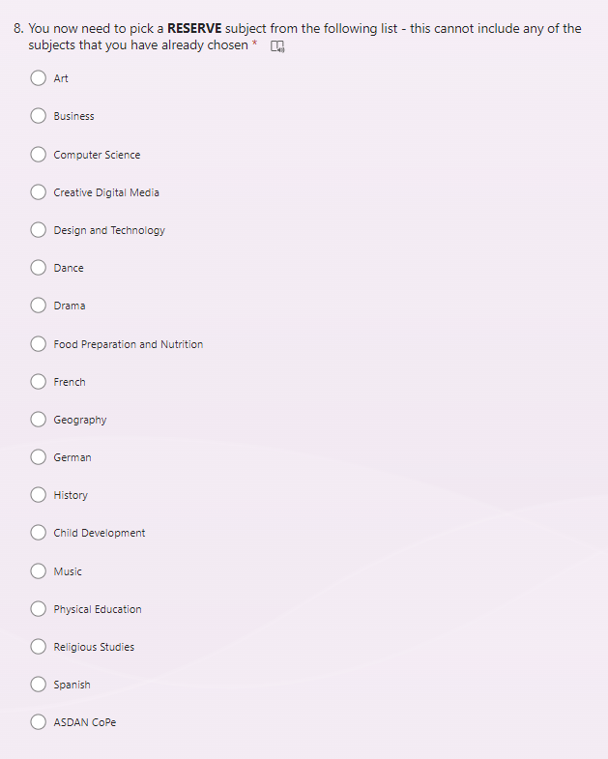
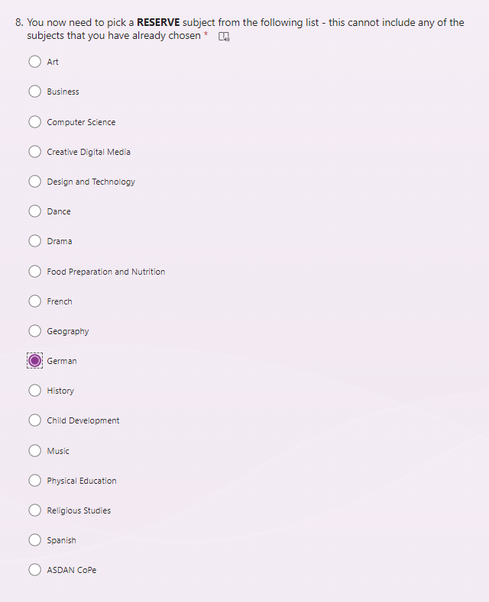
Question 8 on the form – Reserve choice
Just in case there is a situation where we cannot give you one of your four choices, we need you to choose a reserve subject. This cannot be one of the subjects you have already chosen.

Slide 22
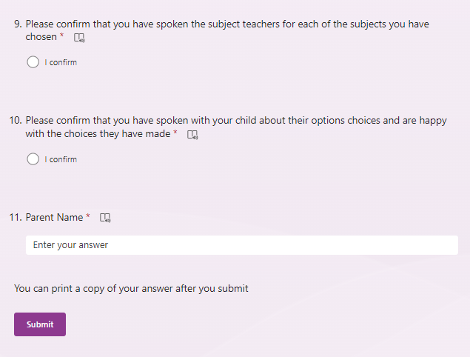
Signing off the Option Form

Slide 23
Final Points

Slide 24

Remember
Careers are not made or broken in Year 9
Keep a broad selection of subjects
Challenge yourself
Do what you enjoy and what you are good at
Take all the help, support, advice and guidance available to you
Read the booklet, talk to subject teachers and watch the presentations
Tonight is about finding out what is involved in studying each subject
Fill in your option form correctly
Make the deadline!

Slide 25

Dates for your diary
Year 9 Options Evening
  Thursday 22nd January (5.30pm – 7:30pm)
Year 9 Parents’ Evening
  Tuesday 27th January
Options Form available
  Wednesday 28th January
Deadline for options form
  Friday 6th February
Checks and conversations will happen in Term 4 (March – April)
Confirmation of choices in mid/late June

Slide 26

If you have questions
If you have any questions about the content of specific option subjects, then please speak to the subject teacher or Head of Faculty in the first instance
If you have a question about how to fill in the options form, then please speak to your child’s tutor
If you need further advice and guidance, please speak to your child’s tutor who can direct you to the most appropriate support
If you have any questions that were not answered on the evening please contact Miss Dundas, Mr Burcombe or Dr Simpson

